Slide 1
Financing opportunities with Erasmus+ youth
Ingeborg Kjærstad
11th November 2023

Slide 2
Agenda
Get to know each other
Get to know Erasmus+
Get to know the funding opportunities
Youth exchanges
Youth participation activities
Small-scale partnerships
Get your ideas going
Get in touch with us
Presentation will be sent to you by the organiser. A list of useful links will be provided on the last slide of this presentation

Slide 3
Get to know each other

Slide 4
Something yellow
Go through the pictures on your phone (do not get lost there)!
Pick a picture with something yellow in it, and share the story of the picture in groups
Notes:
How was it?
Did you find any similarities/differences?
What can this tell us about us? Can this tell us something about our cultures?
Intercultural learning is at the core of Erasmus+ - by meeting people from other cultures, you might learn something about yourselves too

Slide 5
What is Erasmus+?
An EU programme that consist of opportunities in these sectors:
School education
Higher education
Vocational education and training
Adult education
Sport
Youth
Notes:
Erasmus+ er et EU-program, og Erasmus+ youth er kun en liten del av dette.

Slide 6
What is Erasmus+?
An EU programme that consist of opportunities in these sectors:
School education
Higher education
Vocational education and training
Adult education
Sport
Youth
Notes:
Erasmus+ er et EU-program, og Erasmus+ youth er kun en liten del av dette.

Slide 7
Notes:
With the youth part of Erasmus+ it’s all about taking action, participating in democratic life, being active citizens

Slide 8
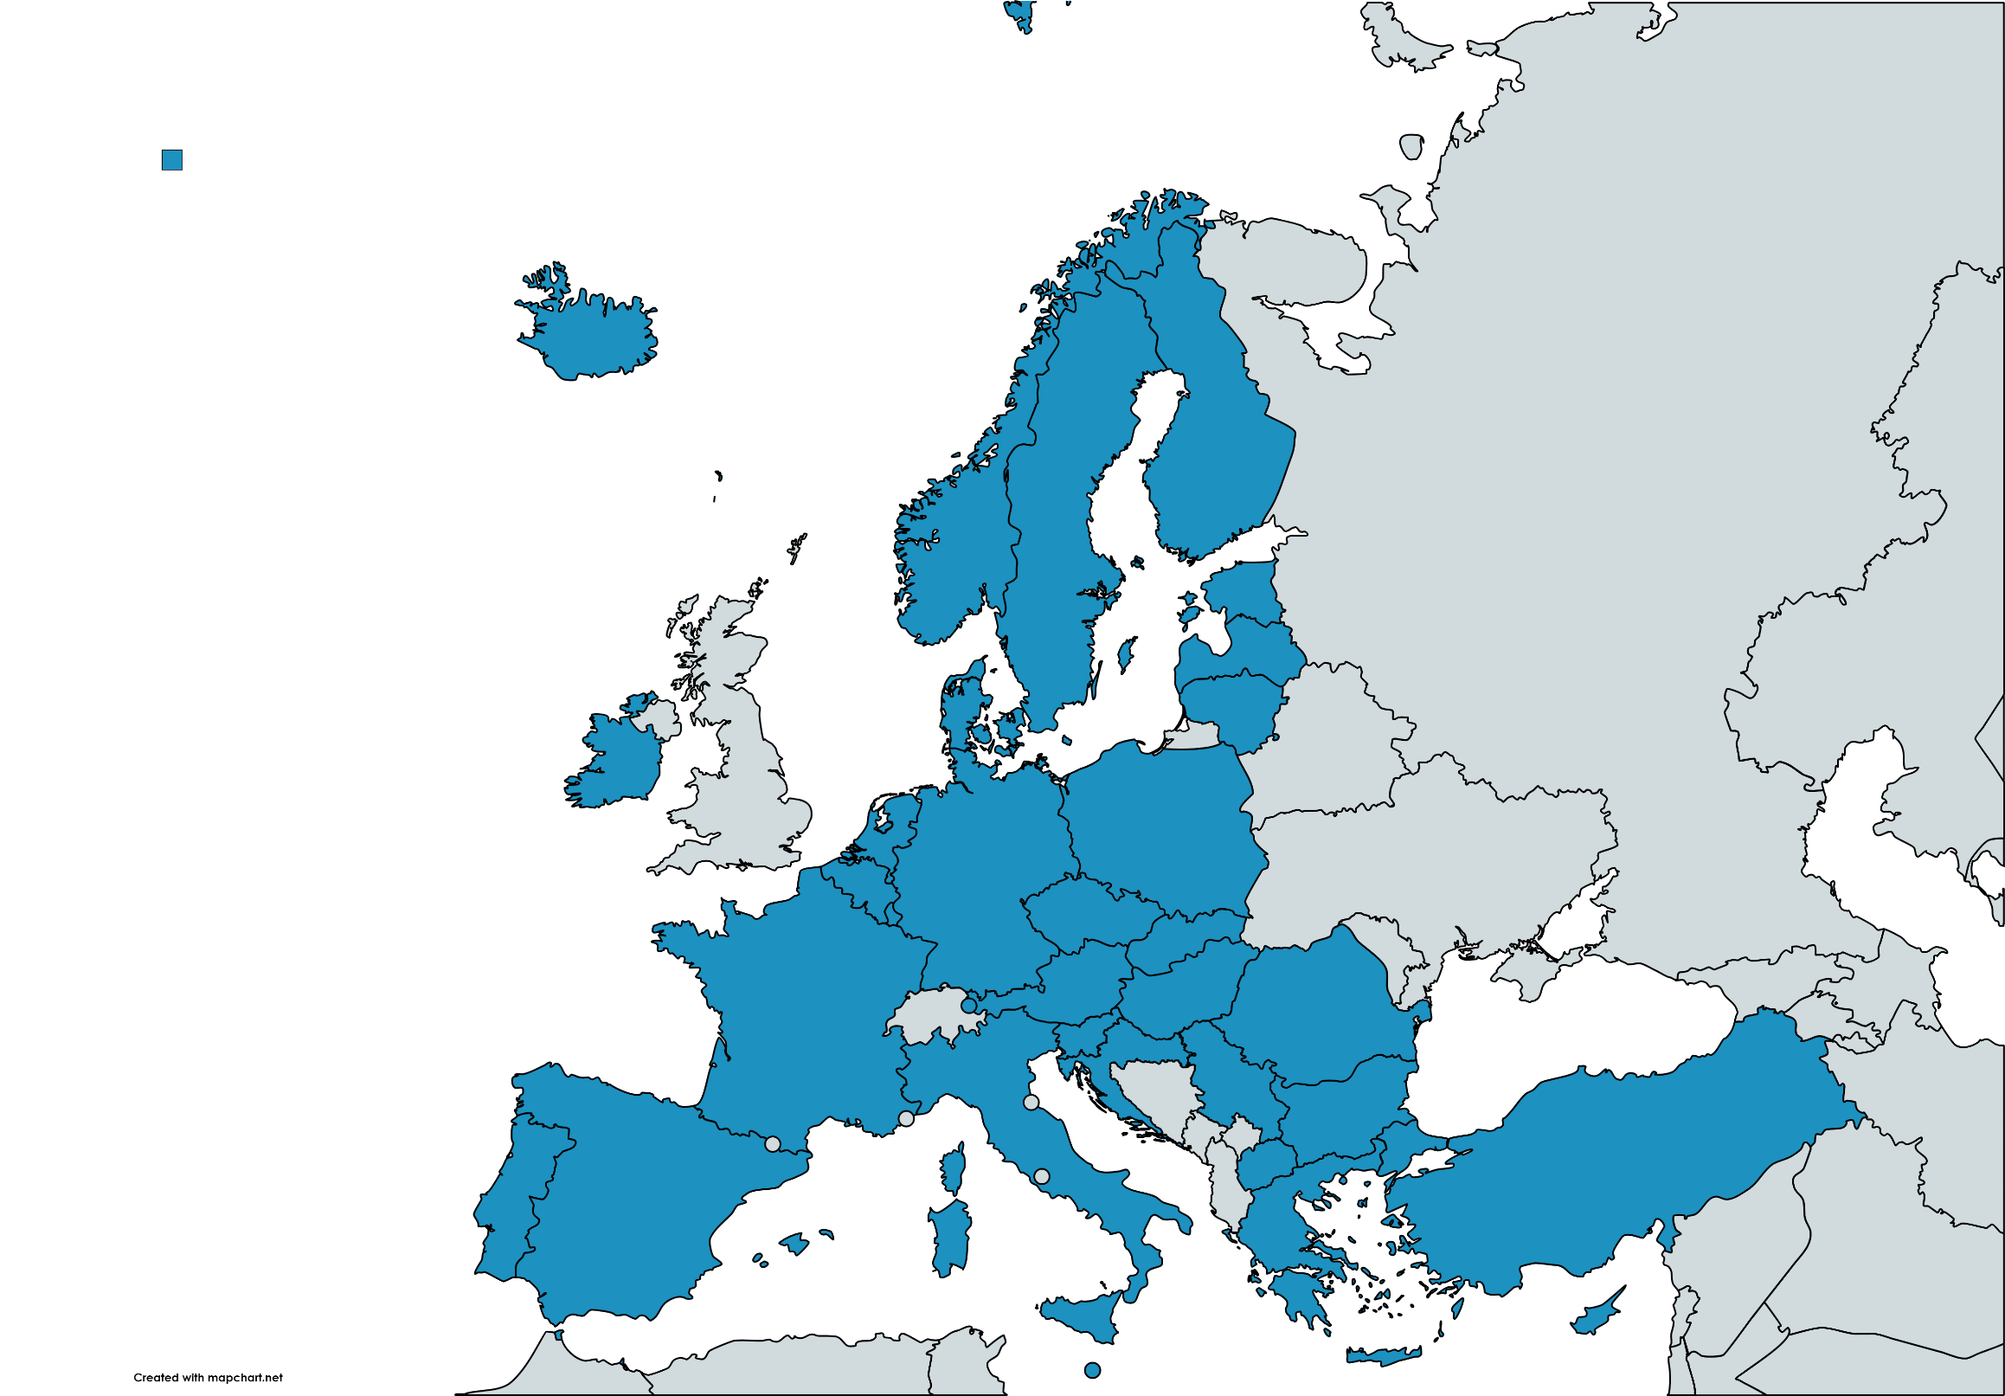
The Erasmus+ countries
The EU countries, but also other countries like Iceland and Norway
Notes:
https://erasmus-plus.ec.europa.eu/programme-guide/part-a/eligible-countries

Slide 9
Funding opportunities
Youth exchanges
Youth participation activities
Partnerships for cooperation

Slide 10
Youth exchanges
An exchange for groups of young people – from at least two different countries
A group of young people can be a youth organisation, a youth council, a theatre group, or something else!
Explore topics (decided by you) while getting to know each other’s countries and cultures
Notes:
Les mer her: https://erasmusplussungdom.no/stotteordning/besok-eller-fa-besok-av-en-annen-ungdomsgruppe/
Og her: https://erasmus-plus.ec.europa.eu/programme-guide/part-b/key-action-1/youth-exchanges

Slide 11
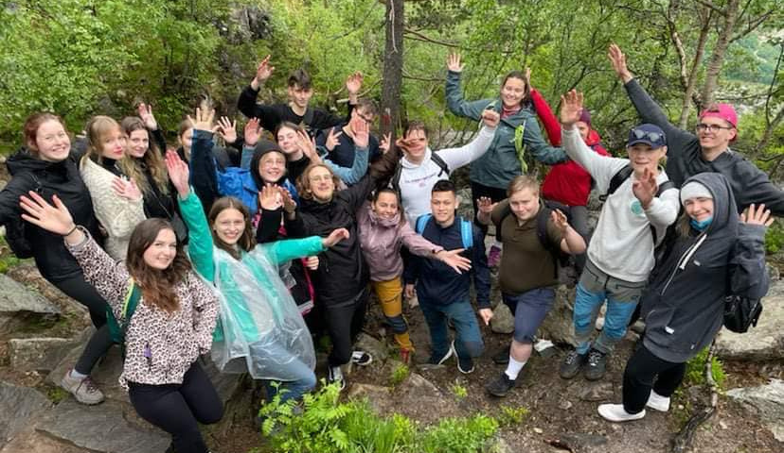
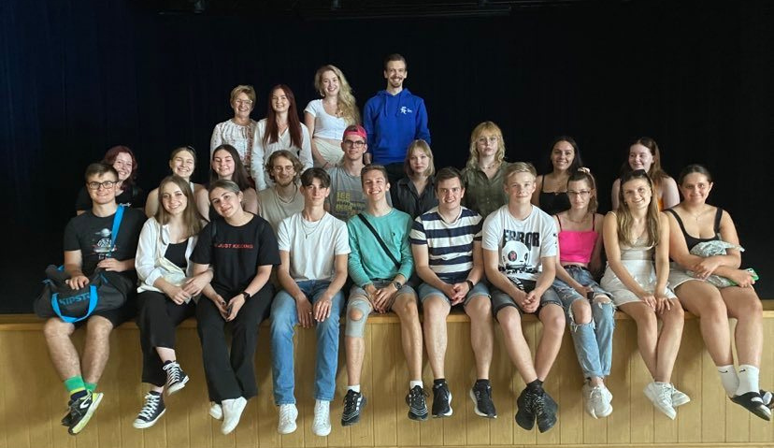
Exchange Norway/Poland
Youth council in Møre og Romsdal + a youth organisation in Poland
2 exchanges – one in Poland and one in Norway
Topics: Culture, and how young people can influence local cultural activities
Notes:
Les mer: https://erasmusplussungdom.no/prosjekt/styrk-ditt-lokale-kulturtilbud/ (Flere eksempler her: https://erasmusplussungdom.no/type-stotteordning/gruppeutveksling/)

Slide 12
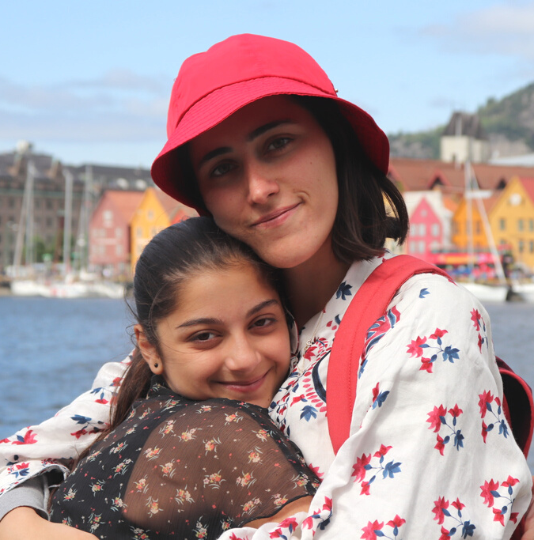
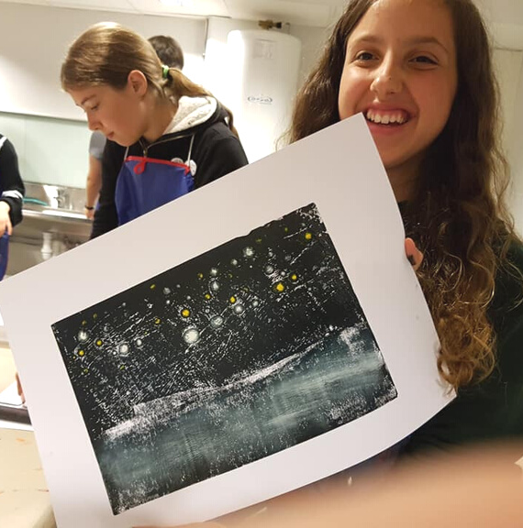
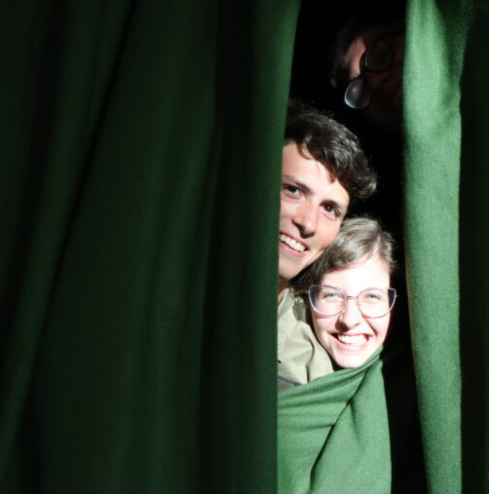
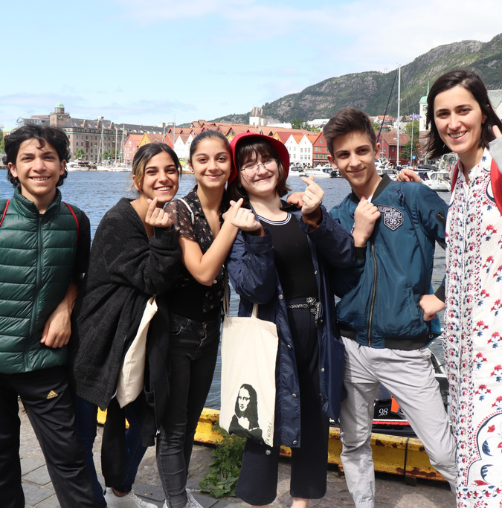
Summer camp
Møllaren youth club, Bergen
Young people from Norway, Italy, Lithuania, Armenia, Georgia, Ukraine
1 week summer camp
Focus on art and creativity
Notes:
Les mer: https://erasmusplussungdom.no/prosjekt/kreativ-sommerleir-i-bergen-2/
(Flere eksempler her: https://erasmusplussungdom.no/type-stotteordning/gruppeutveksling/)

Slide 13
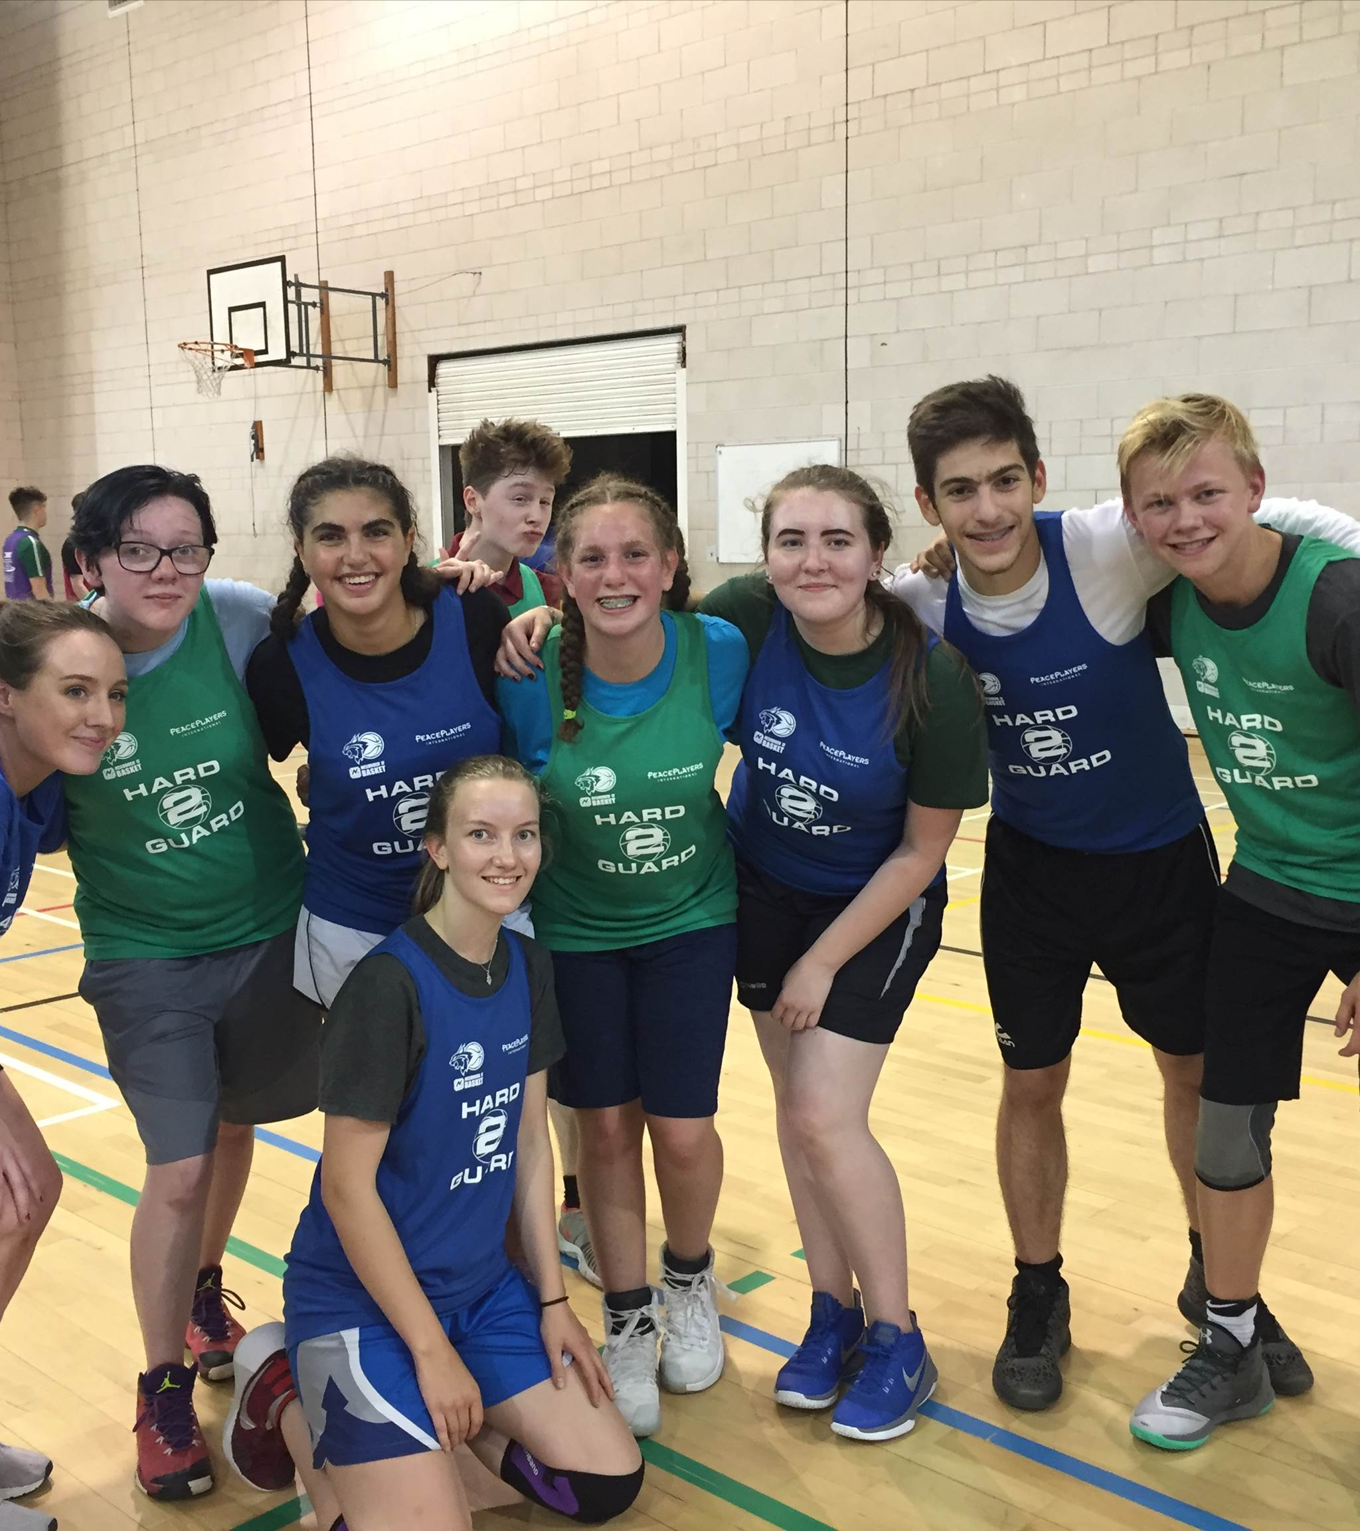
Basket and peace
Nesodden IF Bobcats
Exchange between basket clubs in several countries
Shared interest in basket creates a bridge between cultures
Also focus on peace and conflict prevention
Notes:
Les mer: https://erasmusplussungdom.no/prosjekt/brobygging-gjennom-basket/
(Flere eksempler her: https://erasmusplussungdom.no/type-stotteordning/gruppeutveksling/)

Slide 14
Rules and guidelines
Youth exchanges
What can you get funding for?
Criteria for support
Who can participate?
At least 2 countries
Project period 3 – 24 months
The exchange can be 5 - 21 days
The exchange must be in of the countries that are collaborating
Young people 13 - 30 years
16 - 60 participants
At least 4 from each group
At least one “adult” group leader from each country
Travel
Food, accommodation and activity expences
Pre-visits
Extra support for inclusion or excepitional costs
Expences related to visa, vaccinations, etc
Notes:
Les mer her: https://erasmusplussungdom.no/stotteordning/besok-eller-fa-besok-av-en-annen-ungdomsgruppe/
Og her: https://erasmus-plus.ec.europa.eu/programme-guide/part-b/key-action-1/youth-exchanges

Slide 15
Example
2 youth organisations from Iceland and Denmark
They apply in February 2024, and the project starts in September 2024. In the fall they start planning, and also organise pre-visits.
The main activities are in 2025: June (Denmark) and August (Iceland). 10 participants from each.
They live together, eat together and hang out
They decided that music is the main topic, and explore this through activities
Notes:
Les mer her: https://erasmusplussungdom.no/stotteordning/besok-eller-fa-besok-av-en-annen-ungdomsgruppe/
Og her: https://erasmus-plus.ec.europa.eu/programme-guide/part-b/key-action-1/youth-exchanges

Slide 16
Some time to think
What inspired you?
Notes:
60 seconds to think or write down ideas

Slide 17
Youth participaton activities
provide young people with opportunities to engage and learn to participate in civic society
develop young people’s digital competences and media literacy
bring together young people and decision makers
May be international, but may also be a national or local project
Notes:
Les mer her: https://erasmusplussungdom.no/stotteordning/ungdomsstyrte-prosjekter/
Og her: https://erasmus-plus.ec.europa.eu/programme-guide/part-b/key-action-1/youth-participation
provide young people with opportunities to engage and learn to participate in civic society, by offering pathways of engagement for young people in their daily lives but also in democratic life, aiming for a meaningful civic, economic, social, cultural and political participation of young people from all backgrounds, with special focus on those with fewer opportunities;
raise young people's awareness about European common values and fundamental rights and contribute to the European integration process, including through contribution to the achievement of one or more of the EU Youth Goals;
develop young people’s digital competences and media literacy (in particular critical thinking and the ability to assess and work with information) with a view to increasing young people’s resilience to disinformation, fake news and propaganda, as well as their capacity to participate in democratic life;
bring together young people and decision makers at local, regional, national and transnational level and/or contribute to the EU Youth Dialogue.

Slide 18
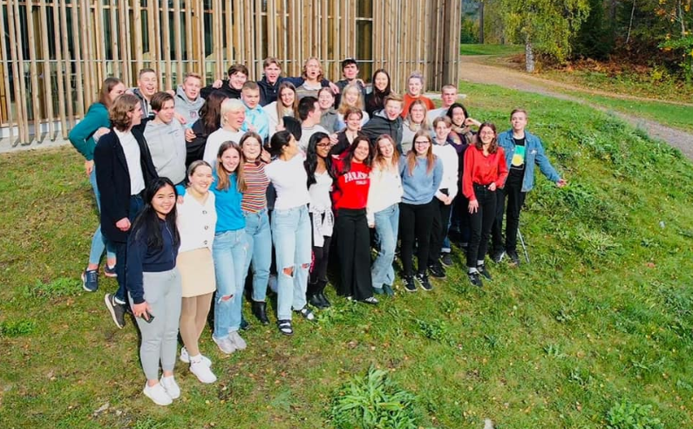
National youth council conference
Youth councils from all 11 regions in Norway
They met over one big conference weekend and several shorter meetings before and after
They made a guide for youth councils in Norway
Notes:
https://erasmusplussungdom.no/arrangement/nasjonal-samling-for-ungdomsradene/

Slide 19
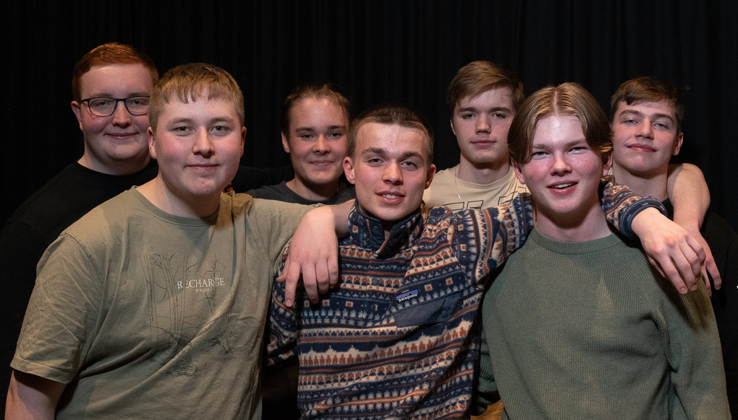
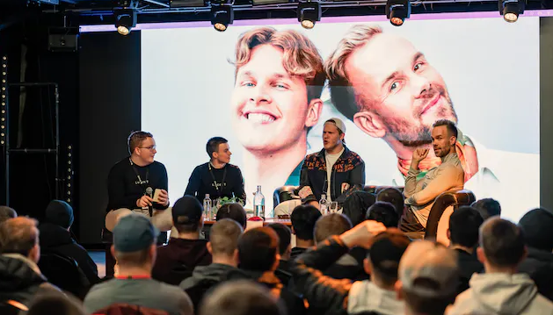
Guttekonferansen
Hammerfest municipality
To mark International day for mental health, for boys and non-binary people in Hammerfest
Goal: make it easier to talk about mental health and that the mental health of male and non-binary people are taken serious
The youth were active in all parts of the project
Notes:
https://erasmusplussungdom.no/prosjekt/guttekonferansen/

Slide 20
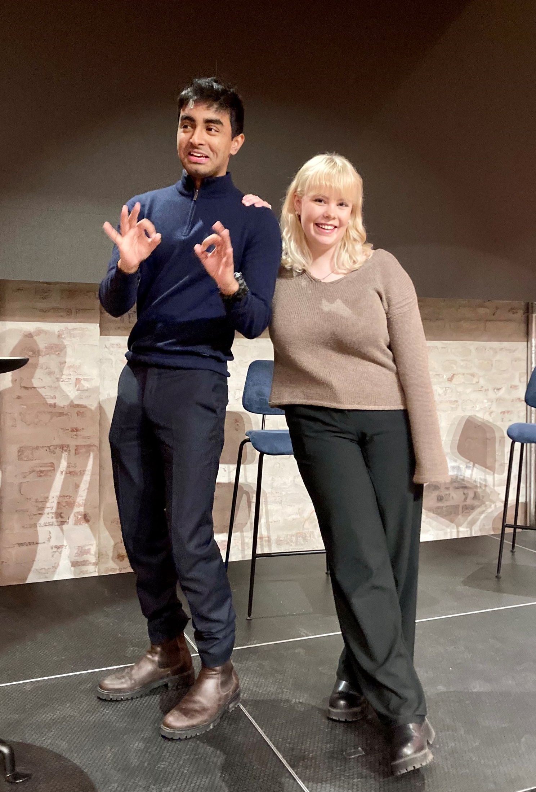
More young voices!
Jeune
Lack of skills and fear of hate may prevent young people from raising their voice in public
Some young students wanted to help young people find their confidence in raising their voice
They organised several workshops within public speaking, how to write opinion pieces, how to get your article published, how to deal with hate speech, etc.
Notes:
https://erasmusplussungdom.no/prosjekt/flere-unge-stemmer/

Slide 21
Rules and guidelines
Youth participation activities
What can you get funding for?
Criteria for support
Who can participate?
Project period 3 – 24 months
Can be local – an international partner is not mandatory
Maximum € 60.000
Young people 13 - 30 years
Decision makers
Events
Activities/meetings
Travel
Keeping the project going (organisational support
Extra support for inclusion
Extra support for green travel
Notes:
Les mer her: https://erasmusplussungdom.no/stotteordning/ungdomsstyrte-prosjekter/
Og her: https://erasmus-plus.ec.europa.eu/programme-guide/part-b/key-action-1/youth-participation

Slide 22
Some time to think
What inspired you?
Notes:
60 seconds to think

Slide 23
Partnerships for cooperation
Create international partnerships and collaborate
Raise the quality of your work, or increase the capacity of your organisation
Create solutions for needs that you identify in the youth field
Make a change!
Choose between “Cooperation partnerships” or “small-scale partnerships”
Notes:
https://erasmus-plus.ec.europa.eu/programme-guide/part-b/key-action-2
Budskap til samfunnet: Å bidra til ungdommers utvikling kan få grenseløse ringvirkninger i samfunnet.
Hele budskapet: Når unge mennesker samarbeider, medvirker og opplever nye ting sammen, utvikler de kunnskap, ferdigheter og holdninger på helt unike måter. Slike menneskemøter – både i lokale prosjekter og på tvers av kulturer og landegrenser – bidrar til økt forståelse, samtidig som de motvirker polarisering.
Kulturutvekslinger gir ungdom anledning til å oppleve andres samfunn, men også til å reflektere over eget. Erfaringer som dette gjør at man knyttes tettere til storsamfunnet man er en del av.
Erasmus+ ungdom jobber for at ungdom i Norge skal ha mulighet til å utvikle seg gjennom slike opplevelser, uansett hvilken bakgrunn og bagasje de har. Det bygges både selvtillit og kompetanse som styrker ungdommen – både som individ og som gruppe.
Å bidra til unge menneskers utvikling er en av de viktigste samfunnsoppgavene vi har. Den innsatsen som legges ned i ungdomsarbeid – både frivillig og lønnet – har en direkte innvirkning på mulighetsrommet til hver enkelt ungdom, og dermed også på samfunnet de er en del av.
Vi vet at programmet vårt fungerer, og gjør oss alle bedre egnet til å bygge et mer inkluderende og åpent samfunn, både i Norge og i Europa.

Slide 24
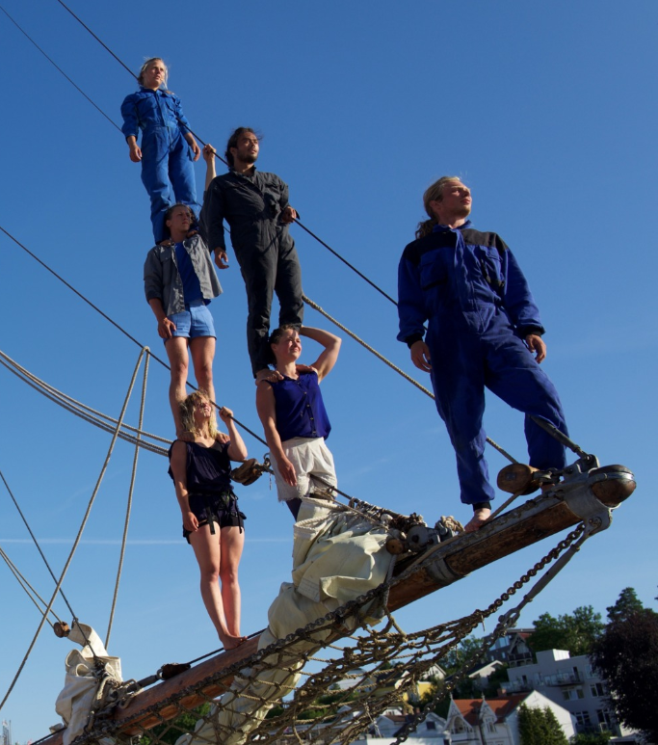
Acting for climate
Young circus artists
Travelling performances around Europe
Focusing on climate change
Notes:
https://erasmusplussungdom.no/prosjekt/seilende-nysirkusforestilling-om-baerekraft-og-miljo/

Slide 25
Give me SoMe Dialog
Vefsn municipality wanted to make an app for young people living there (cultural calendar, health services, public transport, etc)
Collaboration with other Norwegian municipalities: Brønnøy, Hemnes and Rana, as well as Storuman in Sweden, Gornji Milanovac in Serbia, plus a youth organisation (Med ungdom)
Notes:
https://givemesomedialog.com/

Slide 26
Small-scale partnerships
Take your first step into international collaboration!
See how your organisation can grow through working with others
Try to be inclusive! How can this project reach young people that are usually excluded?
Notes:
https://erasmusplussungdom.no/stotteordning/sma-samarbeidsprosjekter/
https://erasmus-plus.ec.europa.eu/programme-guide/part-b/key-action-2/small-scale-partnerships

Slide 27
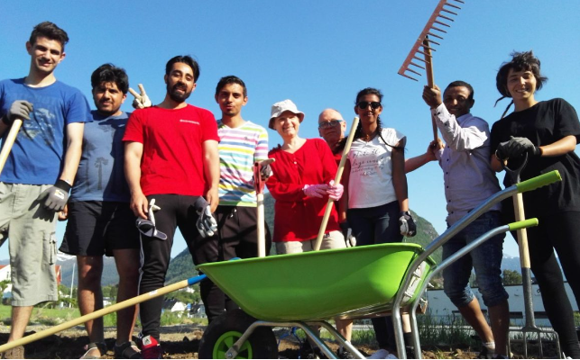
Community garden project
Volda Kyrkjelege fellesråd (Church organisation in a Norwegian municipality)
With organisations in Hungary, Romania and Italy
Young people with minority backgrounds made their own community garden
Better integration in the local community
74 840 euro*
*Now the maximum is 60.000 euro
Notes:
Les mer: https://erasmusplussungdom.no/prosjekt/okologisk-gronnsakshage-for-integrering/
NB: Dette prosjektet fikk egentlig støtte i forrige programperiode, gjennom ordningen «Strategiske partnerskap» - da var det ikke faste sekkebeløp på enten 30 000 eller 60 000 som det er nå. Likevel kan vi si at dette prosjektets omfang tilsvarer det som ville vært et prosjekt med støtte fra «Små samarbeidsprosjekter» i dag

Slide 28
Rules and guidelines
Small-scale partnerships
Apply for a lump sum
Support criteria
Who can apply?
You have to be at least 2 partners from different countries
Project period 6 - 24 months
All partner organisations should have designated tasks in the project
Small / local organisations, newcomers to Erasmus+, organisations that are new to international collaboration
Public or private sector
Active in the youth field
30 000 euro
60 000 euro
Notes:
https://erasmusplussungdom.no/stotteordning/sma-samarbeidsprosjekter/
https://erasmus-plus.ec.europa.eu/programme-guide/part-b/key-action-2/small-scale-partnerships

Slide 29
Some time to think
What inspired you?
Notes:
60 seconds to think

Slide 30
Now what? How to get started?
What do you want to do and what are the needs of your organisation?
Which funding opportunity fits into this?
Find the next application deadline
Find out if you need to partner up with someone
Have any of you any experience with Erasmus+? Do you need a course?
Contact your national agency for Erasmus+

Slide 31
Application deadlines - tbc
February
March
May
October
Notes:
Bruk denne sliden hvis fristene for neste år ikke er klare ennå

Slide 32
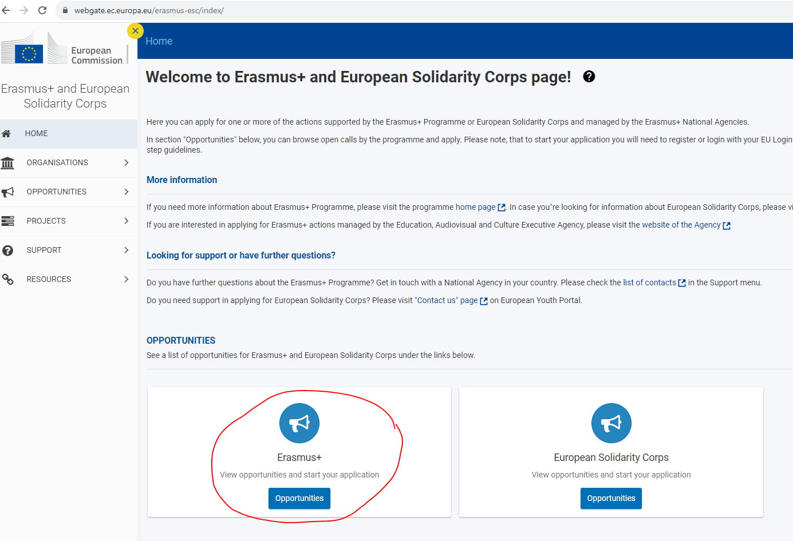
Apply through the EU portal
Notes:
https://webgate.ec.europa.eu/erasmus-esc/index/

Slide 33
How to find partners? How to learn what makes a great project?

Slide 34
Training activities
SALTO-YOUTH organises courses and training activities all over Europe
A small fee that you pay to your national agency covers the participation, travel, food and accommodation
Good way to meet partners!
www.erasmusplussungdom.no/kurs
Notes:
Les mer her: https://erasmusplussungdom.no/kurs/
(skroll nedover forbi kursene for å lese: «Slik søker du om å delta på kurs»

Slide 35
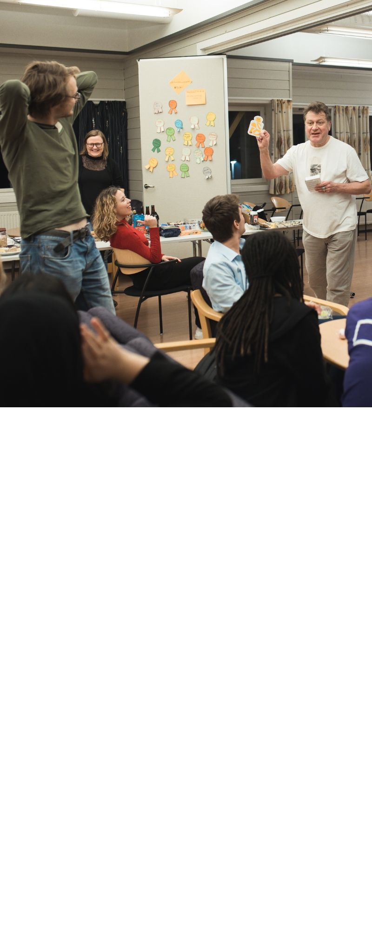
Sustainable well-being of people and planet
Date: 17-20 December 2023
Place: Oslo, Norway
Theme: Green projects, sustainable youth work
Who can join: youth workers, youth organisations, etc
Deadline: 19th November
Notes:
https://www.salto-youth.net/tools/european-training-calendar/training/well-bee-ing-let-it-bee-sustainable-well-being-of-people-and-planet.11759/

Slide 36
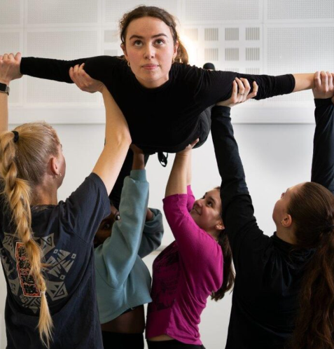
The power of non-formal education
Date: 6-11 February 2024
Place: Italy
Theme: Non-formal learning methods
Who can join: youth workers, youth project leaders, etc
Deadline: 28th November
Notes:
https://www.salto-youth.net/tools/european-training-calendar/training/the-power-of-non-formal-education.11770/

Slide 37
Online challenge: Develop your project
Date: December 2023 - February 2024
Place: Online
Theme: Application support
Who can join: representatives for youth groups, youth project leaders, youth workers, etc
Deadline: 10th December
Notes:
https://www.salto-youth.net/tools/european-training-calendar/training/online-challenge-develop-your-quality-e-esc-project-focused-on-youth-participation.11785/

Slide 38
Norway contact point:
Erasmus+ ungdom, Barne-, ungdoms- og familiedirektoratet (Bufdir)
Website: www.erasmusplussungdom.no
Facebook: @erasmusungdom
Instagram: @erasmusplussungdom
Email: erasmusungdom@bufdir.no
Nyhetsbrev:
Notes:
https://erasmusplussungdom.no/kontakt-oss/

Slide 39
Denmark:
Danish Agency for Science and Higher Education
Address: Haraldsgade 53, DK-2100 Copenhagen Denmark
Phone number: +45 72 31 78 00
Email: uddprogram@ufm.dk
Website: http://www.ufm.dk/erasmusplus

Slide 40
Finland:
Finnish National Agency for Education (EDUFI)
Address: Hakaniemenranta 6, P.O.Box 380 00531, Helsinki Finland
Phone number: +358 295 331 000
Email: erasmus.viestinta@oph.fi
Website: https://www.oph.fi/erasmusplus

Slide 41
Iceland:
The Icelandic Centre for Research (Rannis)
Address: Borgartún 30 105, Reykjavik Iceland
Phone number: +354 515 5800
Email: erasmusplus@rannis.is
Website: http://www.erasmusplus.is/

Slide 42
Sweden:
Swedish Agency for Youth and Civil Society (MUCF)
Address: Liedbergsgatan 4 Box 206 SE - 35230 Växjö Sweden
Phone number: +46 10 1601000
Email: info@mucf.se
Website: http://www.mucf.se/

Slide 43
What did we learn?
Activity: fun, but also a bit of intercultural learning + non-formal learning?
Erasmus+: An EU programme
Funding opportunities for young people
Youth exchanges
Youth participation activities
Small-scale partnerships
Now what?
Identify your wants + needs
Applications deadlines
Go to a training activity / find partners
Get to know the EU application portal
Contact your national agency

Slide 44
Questions?

Slide 45
Bring your ideas to life!
Now: Sign up for a training course if you think you could use one, or get in touch with your national agency!
Before Christimas: set a project group (with or without partners)
Start of January: Starting to look at the application questions
End of January: Draft application ready – can be sent to your National Agency for feedback
Mid-February: Application submitted
Summer 2024: project start date!
Notes:
Sometimes it can help to think backwards

Slide 46
Bring your ideas to life!
Tasks / things to consider
(assign WHO & WHEN):
Contact your National E+ Agency
Read up on guidelines and criteria
Decide on the project format (conference, workshops, exchange, making a product, etc)
Decide how many participants there will be
Decide on the length of the activities / events
Decide on the content
Make a user login and register your organisation in the EU portal
Write the application
What kind of project do you want to create? What do you want to achieve?
Which funding opportunity will you apply for?
What do you need before you can start planning? More information? A partner? Guidance from your national agency? A training course?
Which deadline will you apply for? What do you need to do before that?
Notes:
Look here for Norwegian guides: https://erasmusplussungdom.no/veiledning/
Maybe your National Agency have made something similar?

Slide 47
Useful links
Erasmus+ Programme Guide (all the rules and guidelines for all funding opportunities within Erasmus+):
https://erasmus-plus.ec.europa.eu/programme-guide/erasmus-programme-guide/introduction
Training courses for finding partners or learning about quality youth projects:
https://www.salto-youth.net/tools/european-training-calendar/
Erasmus+ application portal:
https://webgate.ec.europa.eu/erasmus-esc/index/

